Slide 1
Tic-Tac-RL 5x5 RL agents learn to play 5x5 tic-tac-toe using Q-table
Denis Grankin, Artem Vergazov, Anna Shkromada
Reinforcement Learning, 2023

Slide 2
Tic-tac-toe 5x5 is an expanded version of the classic tic-tac-toe game, played on a larger grid of 5 rows and 5 columns. It follows similar gameplay mechanics, but with a few key differences compared to the original 3x3 version.
2

Slide 3
The 5x5 version has a larger grid, providing more spaces for players to make their moves. This increases the complexity and strategic options available compared to the limited 3x3 grid.
3
5x5

Slide 4
In Tic-tac-toe 5x5, the win condition is usually extended to forming a line of FOUR Xs or Os. This requires more planning and foresight to achieve victory.
4

Slide 5
The main goal of the project is to train an RL agent to play 5x5 tic-tac-toe. To do this, we…
5
Implement an environment that in response to actions on the part of the agent will return the changed state of the board and the reward;
Implement a random agent for our agent to train on initially;
Implement a tabular Q-learning player and train it.

Slide 6
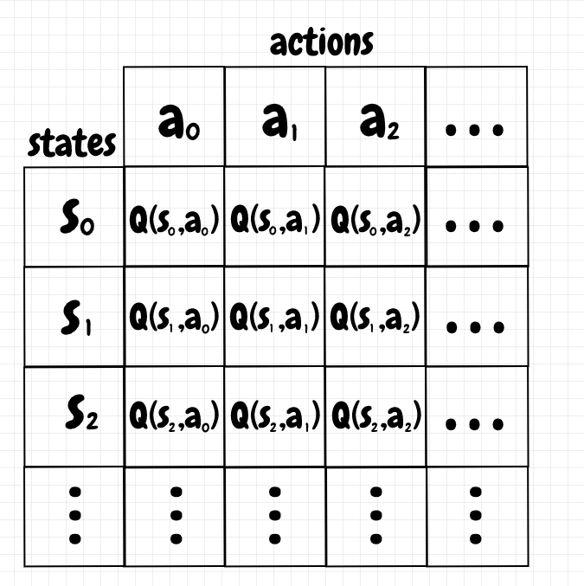
Tabular Q-Learning
6
Tabular Q-learning is a Q-learning algorithm that stores the Q-values of all possible state-action pairs in a table.
Suitable for situations:
State and action space is discrete and small enough to be represented as a table.
Notes:
For this task, we’ve decided to choose one of the tabular methods – Tabular Q-learning. It is an RL algorithm that stores the Q-values of all possible state-action pairs in a table. An ideal use case for this category of methods would be a small and discrete state and action space – which is needed to represent them as a table

Slide 7
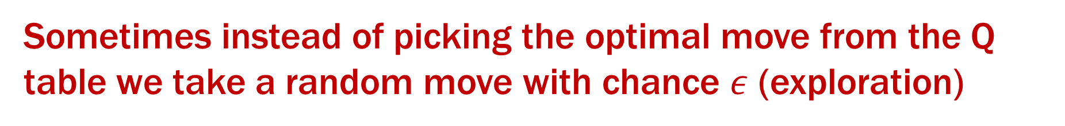
Tabular Q-Learning
7
The new Q value takes into account the previous Q-value, the reward we got for taking action a in state s and the Q-values of the possibles moves after taking action a in state s
$Q^{new\left(s_{t},a_{t}\right)}←Q\left(s_{t},a_{t}\right)+α{[R(s}_{t},a_{t})+γ\max_{a}{Q\left(s_{t+1},a\right) −}$ $Q\left(s_{t},a_{t}\right)]$
old Q-value of taking action a in state s
instantaneous reward
the maximum Q-value we can get for our next move after taking action a and ending up in state s+1
Sometimes instead of picking the optimal move from the Q table we take a random move with chance $ε$ (exploration)

Slide 8
Reward
\
8
Outcome | Reward
Agent wins | +10 (big positive)
Agent loses | -10 (big negative)
Draw | +5 (smaller positive)

Slide 9
Training method
9
Step 1.
Initially, we teach the Q-learning agent to play against random agent
Q-learning agent 1
Random agent
vs
Step 2.
We copy our newly taught Q-agent to env class and it learns to play against itself
Q-learning agent 2
Q-learning agent 1
vs
Step 3.
We repeat the process several times and collect the statistics
Q-learning agent 3
Q-learning agent 2
vs

Slide 10
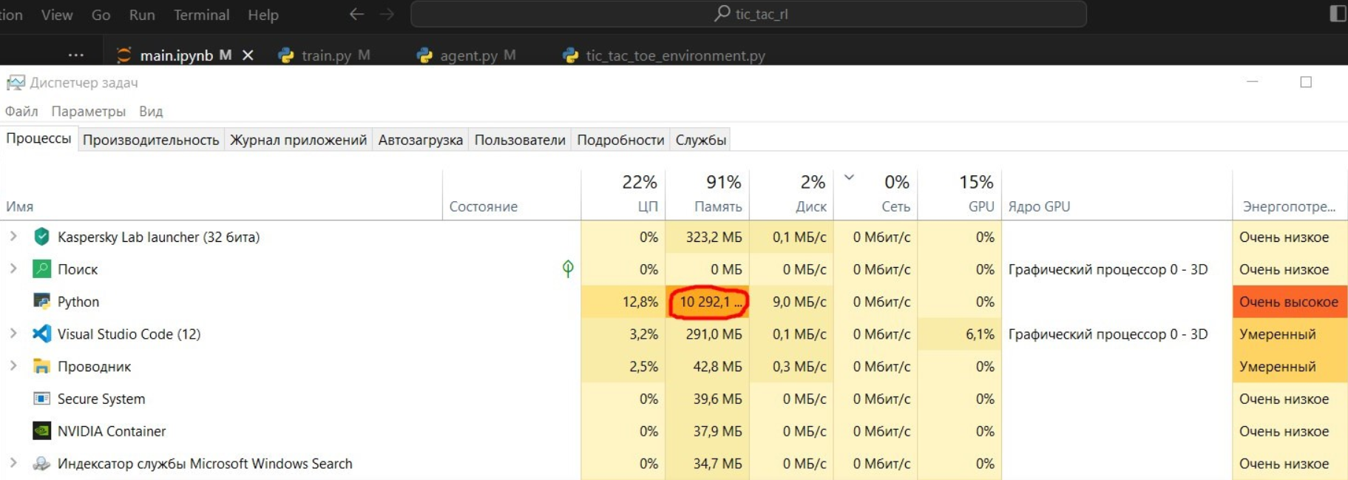
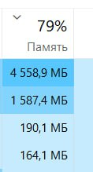
Results
10
At first, we’ve noticed that the agent was learning way too slow and decided to increase the number of iterations. Then, we’ve ran out of memory…

Slide 11
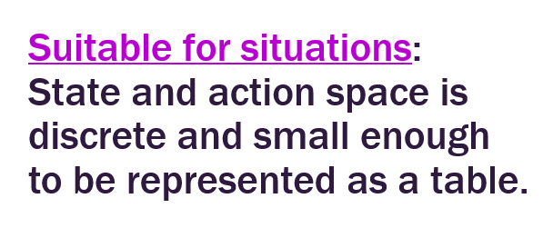
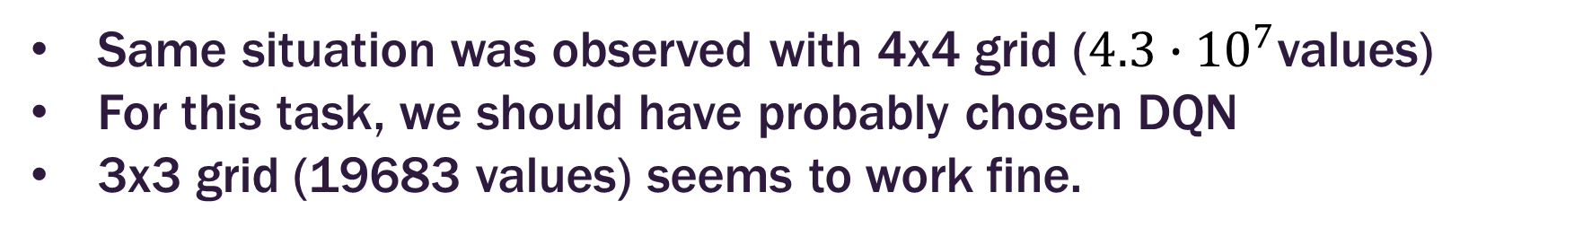
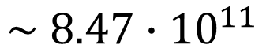
Lessons learnt
11
We’ve underestimated the actual amount of state-action pairs. Even though the grid is only 5x5 = 25 cells, all possible combinations for Q-table would take maximum
$$\sim 8.47∙{10}^{11}$$
values to store.
As a result, we’ve ran out of memory to store our huge Q-table.
Same situation was observed with 4x4 grid ($4.3∙{10}^{7}$values)
For this task, we should have probably chosen DQN
3x3 grid (19683 values) seems to work fine.
New plan….

Slide 12
Tic-Tac-RL 5x5 RL agents learn to play 5x5 tic-tac-toe using Q-table
3x3
3x3
Denis Grankin, Artem Vergazov, Anna Shkromada
Reinforcement Learning, 2023

Slide 13
The new main goal of the project is to train an RL agent to play 3x3 tic-tac-toe. To do this, we…
13
Implement an environment that in response to actions on the part of the agent will return the changed state of the board and the reward;
Implement a random agent for our agent to train on initially;
Implement a tabular Q-learning player and train it.
Basically do the same steps but with smaller grid

Slide 14
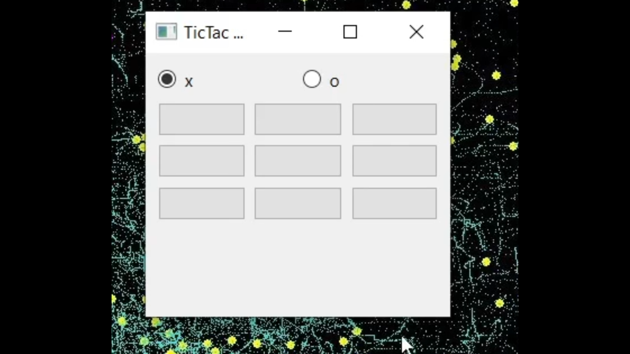
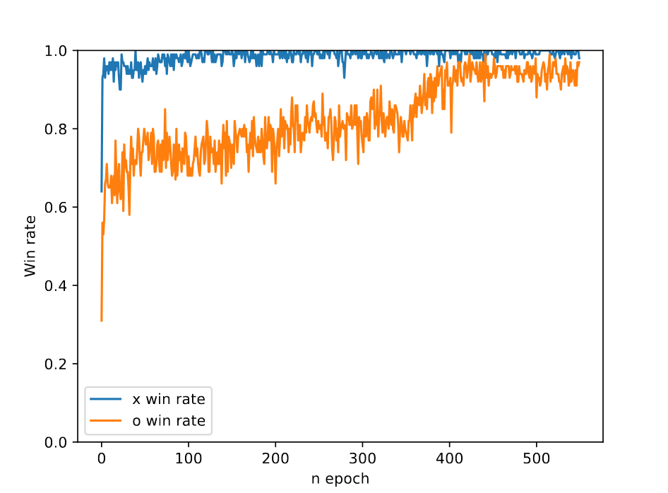
Results
14
Trained player versus human
Win rate over time for x and o versus random

Slide 15
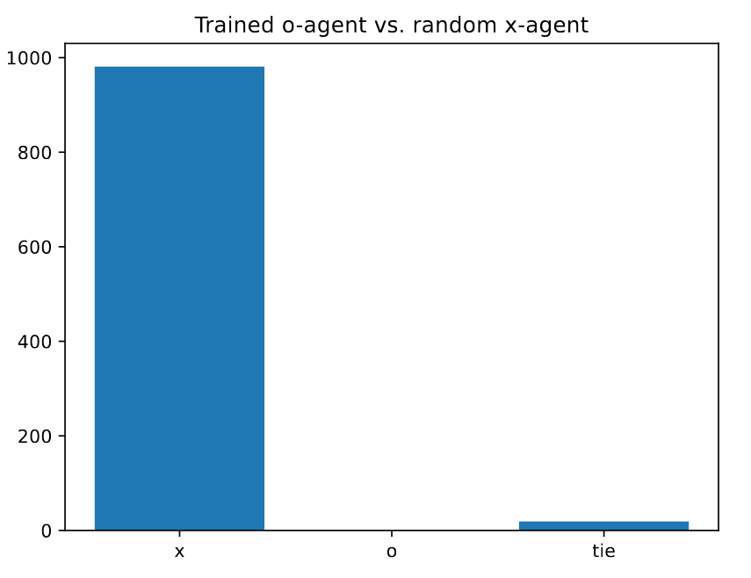
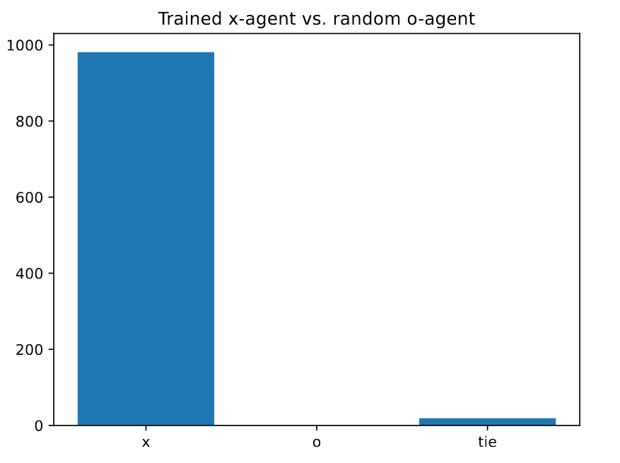
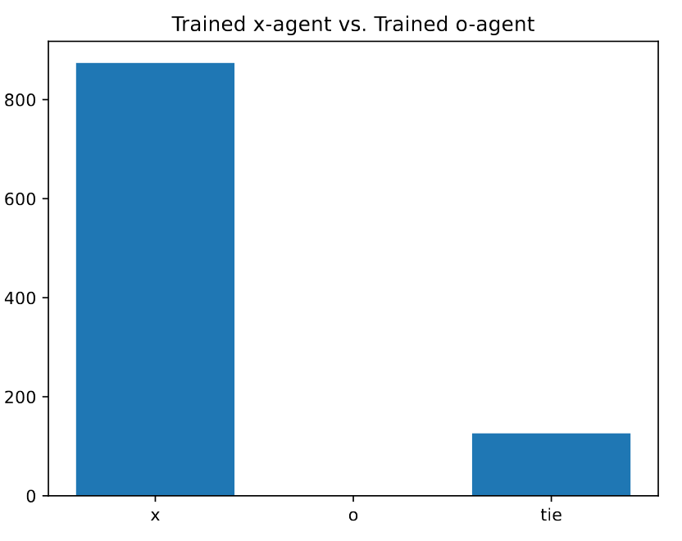
Results
15
Both the trained agent playing as x and the trained agent playing as o show good results versus random player. However, trained x almost always wins with trained o.
Q-o vs random x
Q-x vs random o
Q-x vs Q-o

Slide 16

Check out our GitHub
16
https://github.com/ArtemVergazov/tic_tac_rl

